Slide 1
02 Trending Insights

Slide 2
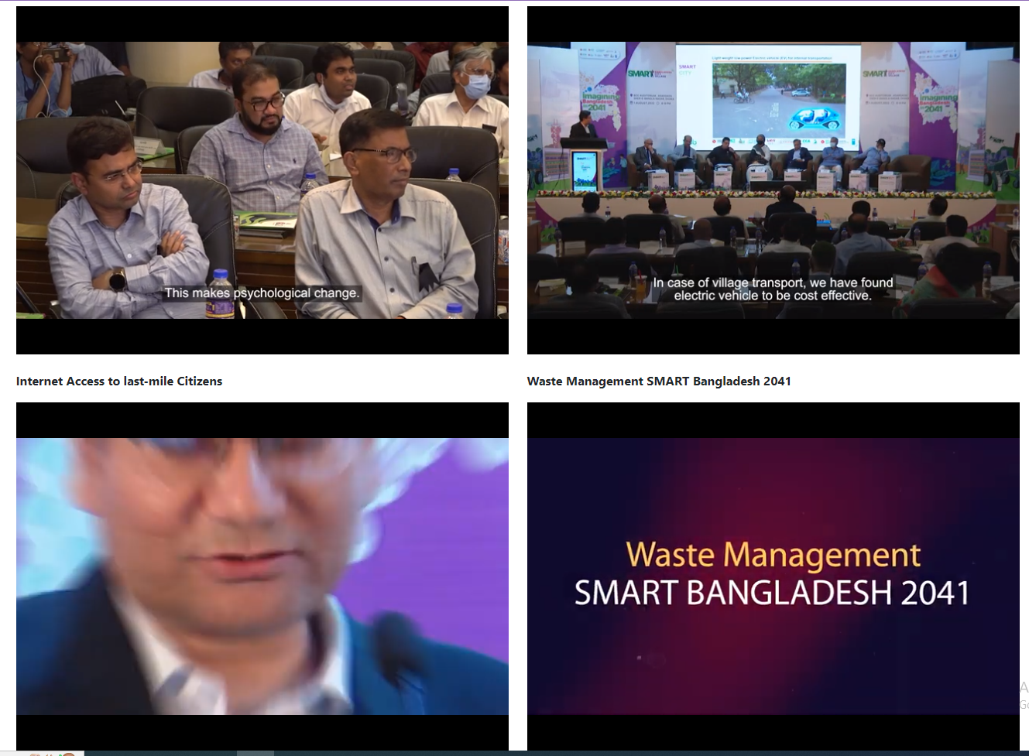
Item 1 - Smart Bangladesh Vision 2041
Multiple Videos are playable at the same time. Only one video should be playable.

Slide 3
Item 1 - Smart Bangladesh Vision 2041 - continued
DONE
Change title of “BCC Campaign through Using Data SMART BANGLADESH 2041” to “Behavior Change Communication Campaign through Using Data SMART BANGLADESH 2041 by Anir Chowdhury”
Include the video from the given Youtube Links:
https://www.youtube.com/watch?v=EVn50UshtUg&t=80s
https://www.youtube.com/watch?v=gvehjq_Z9FU
https://www.youtube.com/watch?v=d_tq0z3W-Hk

Slide 4
Item 2 - BBC article on a2i
DONE
Remove this section.

Slide 5
Item 3- Enhancing Equality through e-Quality
DONE
Use the updated image as given in the drive link: **please wait for link

Slide 6
Item 4- Blended Education Accelerator
Include the video from the given drive link:
https://drive.google.com/file/d/1iFLnam4jvBqrYNGd31K-5Sh8kz0WhDrl/view?usp=sharing

